Slide 1
Fast API
Task Requirements:
Deploy a simple HTTP server with two endpoints:
1. POST endpoint - Appends a JSON payload to a local file
2. GET endpoint - Returns the last 10 payloads from the persisted file
Work Environment: Visual Studio Code in Python
Tools I Used:
JSON file: I downloaded from this link: https://www.agentsfordata.com/json/sample the “House Prices” file and named it payloads.json
FastAPI: Modern web framework for building APIs
Uvicorn: ASGI server to run the FastAPI application
Commands I Used:
Installation Commands: python -m pip install fastapi uvicorn
Running the Server: python -m uvicorn fast_API:app --reload
Testing Commands:
I opened http://localhost:8000/docs and there I tested the GET and POST
What I Had to Learn:
It was my first time using FastAPI, I learned a lot, how to use GET and POST, the difference between them and when to use each
Work date: 29/12/2025

Slide 2
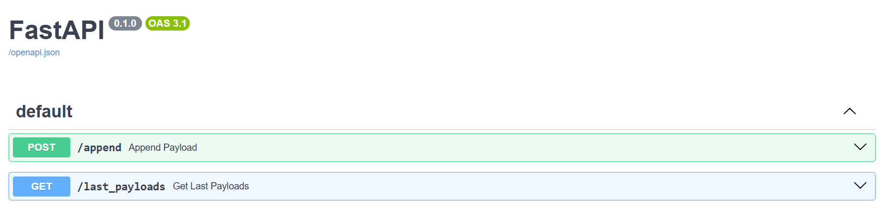
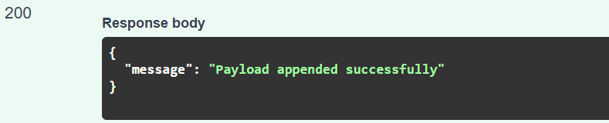

Slide 3
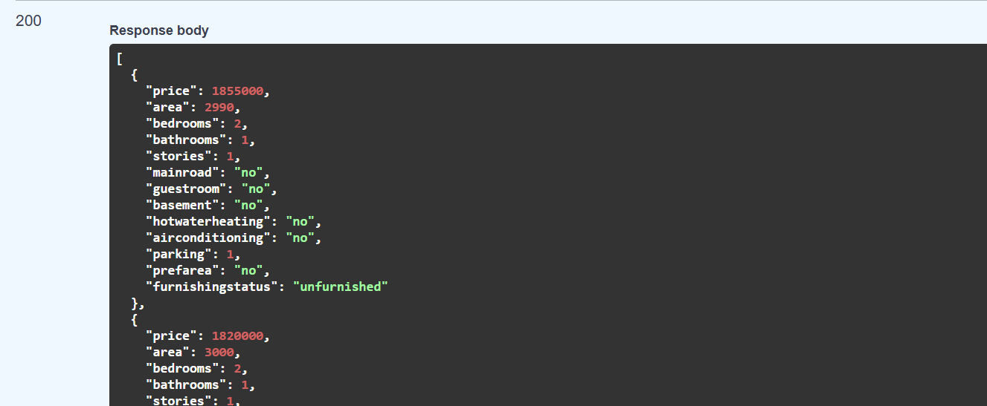

Slide 4
2. Typer CLI
Task Requirements:
Create a simple CLI tool with two commands:
add command: Appends a JSON argument to a local file
get-last command : Returns the last 10 arguments from the persisted file
Work Environment: Visual Studio Code in Python
Tools I Used:
Typer: Python library for building CLI applications
JSON file: I downloaded from this link: https://www.agentsfordata.com/json/sample the “House Prices” file and named it payloads.json
Commands I Used:
Installation Command: python -m pip install typer
Running the CLI:
Add data: python typer_cli.py append '{DATA_TO_ADD}'
Get last 10: python typer_cli.py last_payloads
What I Had to Learn:
It was my first time building a CLI tool, I learned what CLI (Command Line Interface) means - a program that runs in the terminal with text commands instead of buttons
Work date: 29/12/2025.

Slide 5
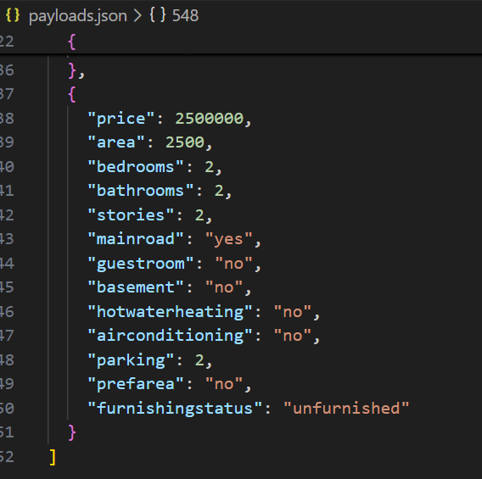

Slide 6
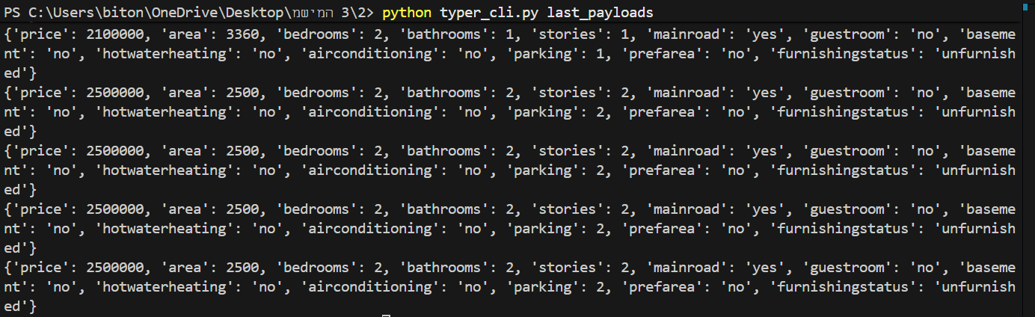

Slide 7
3. VitePress
Task Requirements: Deploy a simple documentation website with two pages:
Landing Page: Introduces a fake software tool “SnapTranslator”, explaining its purpose and features.
Installation Guide: Provides step-by-step instructions for installing and running the tool (commands are illustrative, not real).
Work Environment: Visual Studio Code in combination with Command Prompt, Node.js installed
Tools I Used:
VitePress: Static site generator for documentation websites
Node.js and npm: Required to install and run VitePress
Markdown: To write the content of the pages (index.md and installation.md)
Commands I Used:
Initialize npm project: npm init -y
Install VitePress: npm install vitepress --save-dev
Running the Site: npm run dev
Page Navigation: Opened http://localhost:5173 in the browser to test the pages.
What I Had to Learn: How to create a VitePress project from scratch, how to structure a documentation site with multiple pages and how to run the site locally and view changes in real-time
Work Date: 29/12/2025

Slide 8
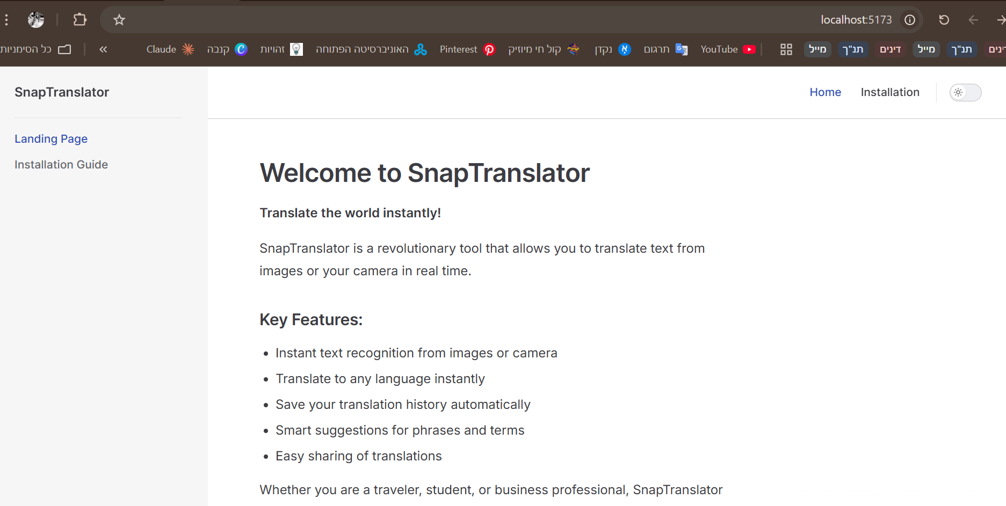

Slide 9
4. Dockerfile – FFmpeg
Task Requirements:
Create a Dockerfile that: Uses a base image of my choice, installs the ffmpeg package and defines an entrypoint that runs ffmpeg automatically when the container starts
Work Environment: Docker Desktop and Visual Studio Code
Tools I Used:
Dockerfile: Used to define the steps for building a Docker image Ubuntu 22.04 (Base Image): Chosen for stability and easy installation of ffmpeg FFmpeg: A powerful multimedia tool for video and audio processing
Commands I Used:
Build Command: docker build -t my-ffmpeg .
Run & Test Commands:
docker run --rm my-ffmpeg -version
docker run --rm -v ${PWD}:/data my-ffmpeg -i /data/input.mp4 /data/output.avi
What I Had to Learn:
What a Dockerfile is and how Docker images are built, how to run ffmpeg commands inside a container
Work Date: 29/12/2025

Slide 10


Slide 11
5. Python Docker
Task Requirements:
Use Python’s docker package to: Run a BusyBox container, keep the container running using the sleep command and execute an additional command inside the running container to retrieve the container hostname
Work Environment: Docker Desktop and Visual Studio Code in Python
Tools I Used:
Docker package: Used to control Docker containers directly from Python code
BusyBox image: A lightweight Linux container used for testing and learning Docker basics
Commands I Used:
Installation Command: python -m pip install docker
What I Had to Learn:
How to work with Docker from Python instead of using the terminal, how to run containers programmatically, how to keep a container running using sleep
Work Date: 30/12/2025

Slide 13
6. Coordinates Conversion
Task Requirements: Convert geographic coordinates from Decimal Degrees (DD) format to Degrees, Minutes, Seconds (DMS).
Work Environment: Visual Studio Code in Python
Logic Implemented:
Extract degrees from the integer part of the DD value
Convert the fractional part to minutes and seconds
Assign direction (N/S for latitude, E/W for longitude) based on the sign
Testing:
I Created a manual tester that compares the actual output to an expected result, iIf the output matches exactly, the program prints Test passed
What I Had to Learn:
How geographic coordinates are represented in DD and DMS formats
Work Date: 30/12/2025

Slide 14
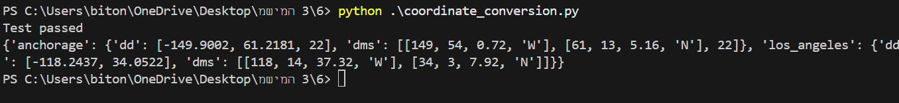

Slide 15
7. Convert Markdown
Task Requirements: Programmatically convert a Markdown document into a PDF file using Python.
Work Environment: Visual Studio Code in Python
Tools I Used:
Markdown (Python package): Converts Markdown text into HTML pdfkit: Python wrapper that converts HTML to PDF wkhtmltopdf: External command-line tool used by pdfkit to generate PDFs from HTML downkoaded from: https://wkhtmltopdf.org/downloads.html
Installation Commands: python -m pip install markdown pdfkit
What I Had to Learn:
How Markdown is converted to HTML before creating a PDF
Work Date: 30/12/2025

Slide 16
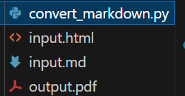

Slide 17
8. Numpy
Task Requirements: Create an RGB color analysis for a chosen image by extracting pixel values and counting how frequently each color appears using NumPy.
Work Environment: Visual Studio Code in Python
Tools I Used:
NumPy: Used to store the image as a numerical array and analyze pixel values Pillow (PIL): Used to load and read the image file Matplotlib: Used to visualize the RGB color distribution
Steps I Performed:
Loaded an image using Pillow.
Converted the image into a NumPy array.
Separated the image into Red, Green, and Blue color channels.
Counted how many times each pixel value (0–255) appears in every channel.
Visualized the results as RGB graphs.
Key Concepts Learned:
How images are represented as 3D NumPy arrays (height, width, 3), how to analyze data without loops using NumPy and how to visualize numerical data using graphs
Work Date: 30/12/2025

Slide 18
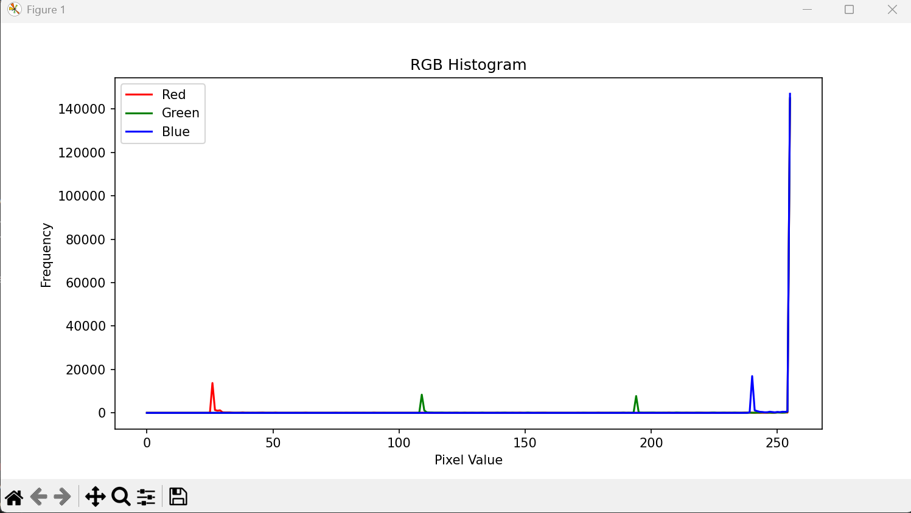

Slide 19
9. Password Strength
Task Requirements:
Write a tool that validates password strength by returning True if the password meets ALL of the following criteria
Work Environment: Visual Studio Code in Python
Tools I Used:
Counter from collections: To count character occurrences
ord() function: To check ASCII values for consecutive sequences
Testing:
I Created a manual tester that checks different passwords, the program prints Test passed if the output is correct
What I Had to Learn:
How to use the ord() function to convert characters to ASCII values and using Counter to efficiently count character occurrences
Work date: 28/12/2025

Slide 20
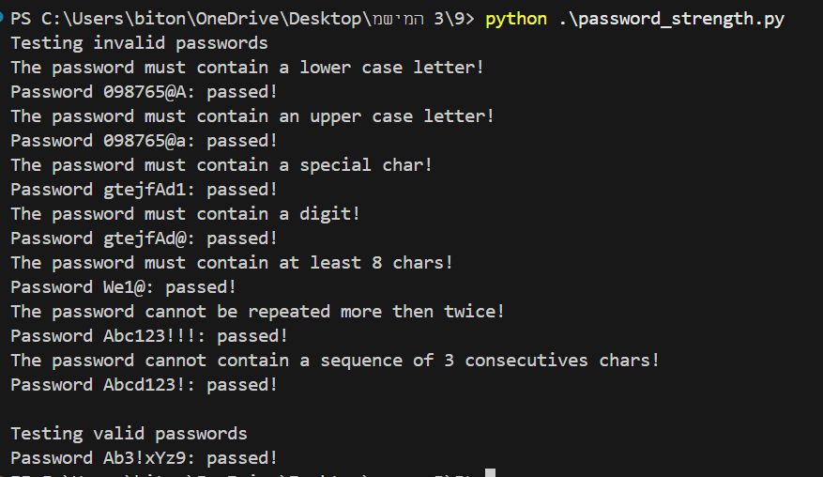

Slide 21
10. K3S:
What k3s Is: k3s is a lightweight version of Kubernetes designed to run in environments with limited resources while still supporting core Kubernetes functionality.
When It Should Be Used:
When running Kubernetes on low-resource machines.
For development, testing, or edge computing scenarios.
When fast setup and simplicity are required.
Where It Can Be Used:
Edge devices and IoT environments.
Virtual machines and local development machines.
Cloud environments where efficiency is important.

Slide 22
Why Use k3s:
Requires fewer system resources than standard Kubernetes.
Easy and fast installation.
Fully Kubernetes-certified and production-ready.
Supports multiple architectures (ARM and x86).
What I Had to Learn: I learned what Kubernetes is at a high level, why a lightweight alternative is useful, and how k3s simplifies Kubernetes deployment while keeping essential features.
Work Date: 30/12/2025

